Slide 1
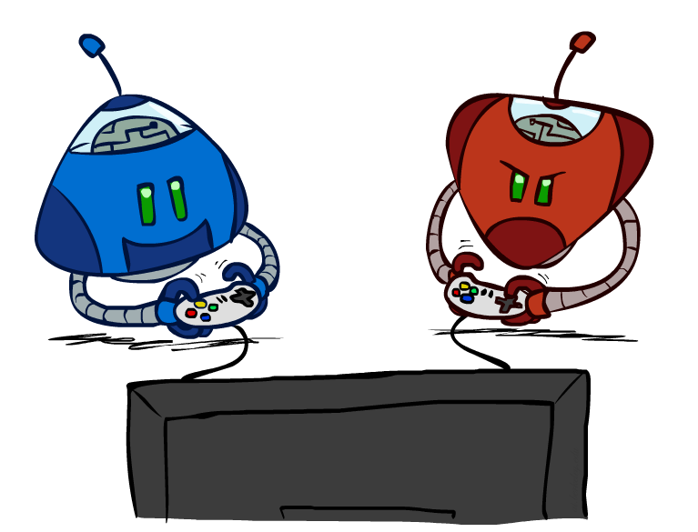
Adversarial Search
Game Playing
Dr. Mohamed K. Hussein
Suez Canal University

Slide 2
Outline
Optimal decisions
α-β pruning

Slide 3
Games vs. search problems
"Unpredictable" opponent → specifying a move for every possible opponent reply

Slide 4
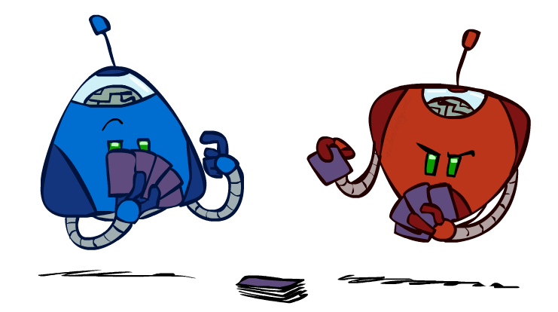
Games in AI
In AI, “games” usually refers to deterministic, turn-taking, two-player, zero-sum games of perfect information
  Deterministic: next state of environment is completely determined by current state and action executed by the agent (not probabilistic)
  Turn-taking: 2 agents whose actions must alternate
  Zero-sum games: if one agent wins, the other loses
  Perfect information: fully observable

Slide 5
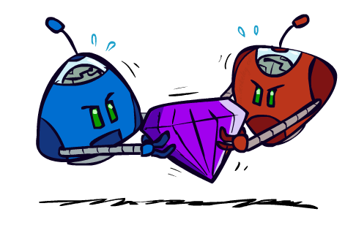
Games in AI
Rich tradition of creating game-playing programs in AI
Many similarities to search
Most of the games studied
  have two players,
  are zero-sum: what one player wins, the other loses
  have perfect information: the entire state of the game is known to both players at all times
E.g., tic-tac-toe, checkers, chess, Go, backgammon, …
  Will focus on these for now
Recently more interest in other games
  Esp. games without perfect information; e.g., poker
    Need probability theory, game theory for such games

Slide 6
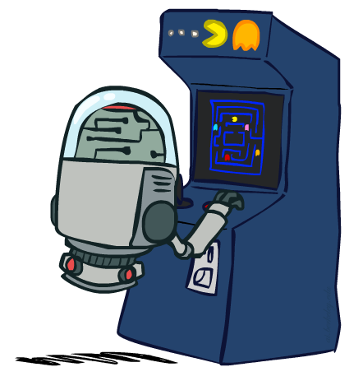
Games as Search
States:
    board configurations
Initial state:
    the board position and which player will move
Successor function:
    returns list of (move, state) pairs, each indicating a legal move and the resulting state
Terminal test:
    determines when the game is over
Utility function:
    gives a numeric value in terminal states
    (e.g., -1, 0, +1 for loss, tie, win)

Slide 7



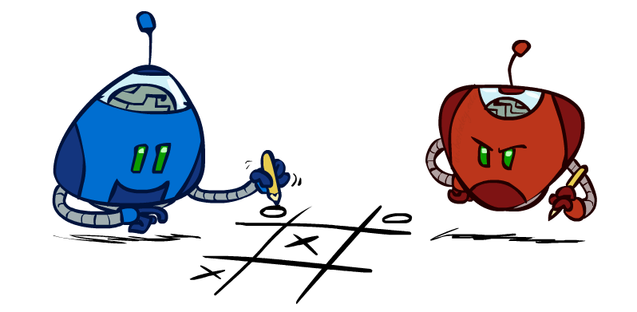
Game tree (2-player, deterministic, turns)

Slide 8
Minimax Algorithm
2
2
1
2
1
2
7
1
8
2
7
1
8
2
7
1
8
This is the move
selected by minimax
2
Static evaluator
value
2
1
MAX
MIN
2
7
1
8

Slide 9
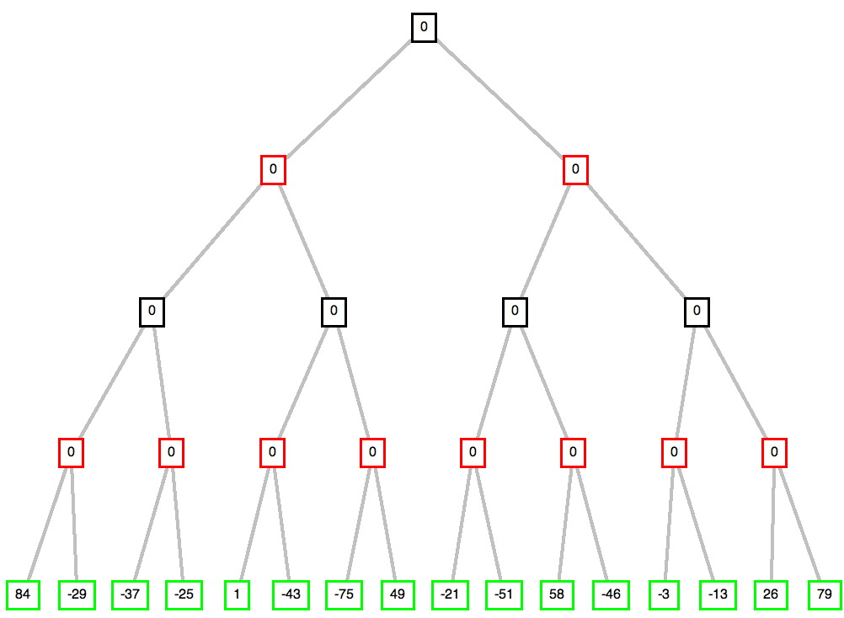
max
min
max
min
© Patrick Winston

Slide 10
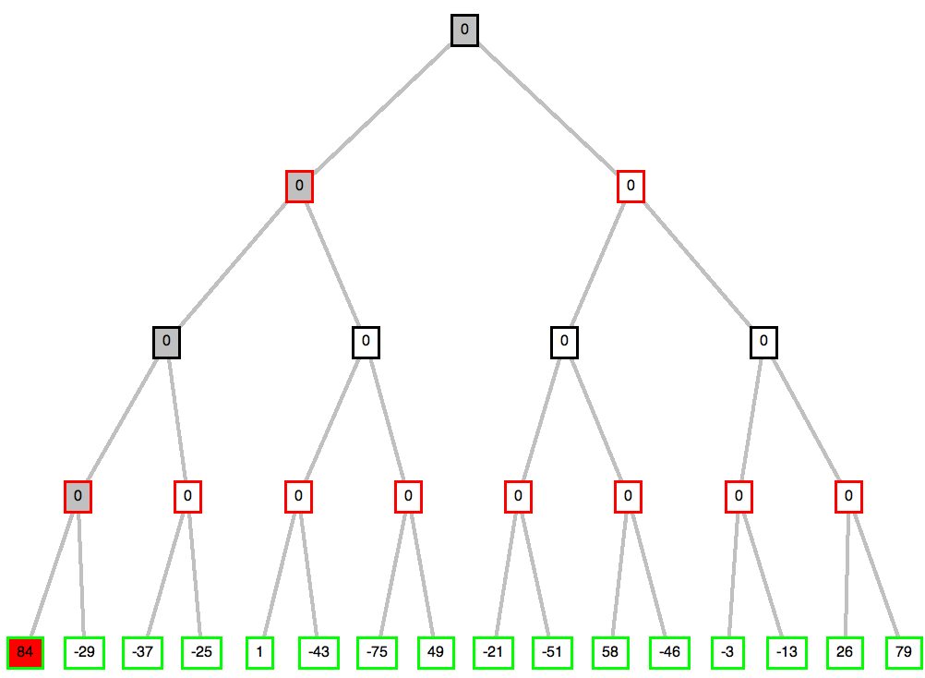
max
min
max
min
© Patrick Winston

Slide 11
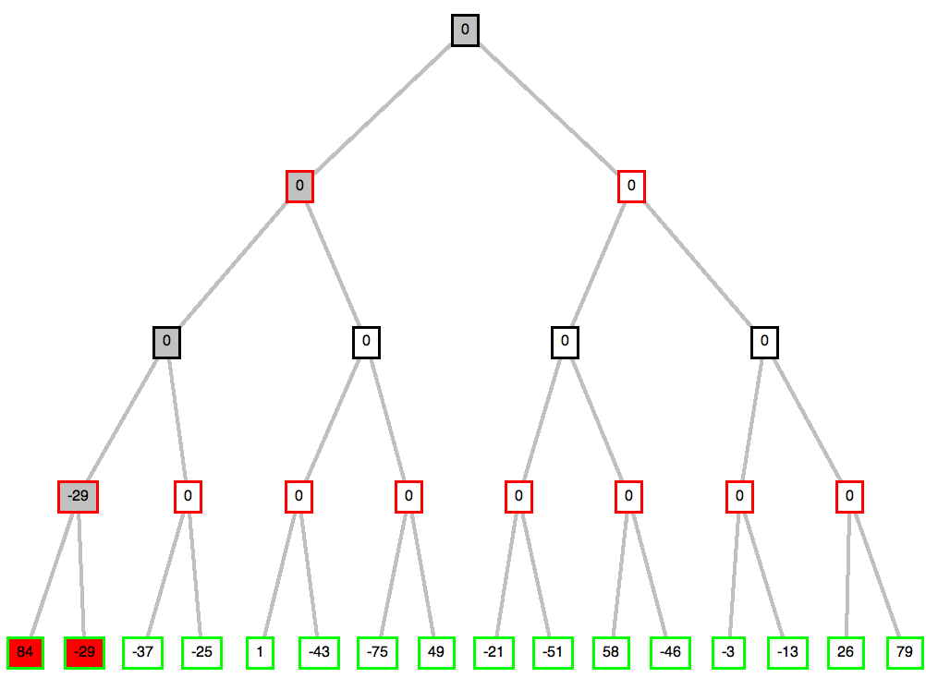
max
min
max
min
© Patrick Winston

Slide 12
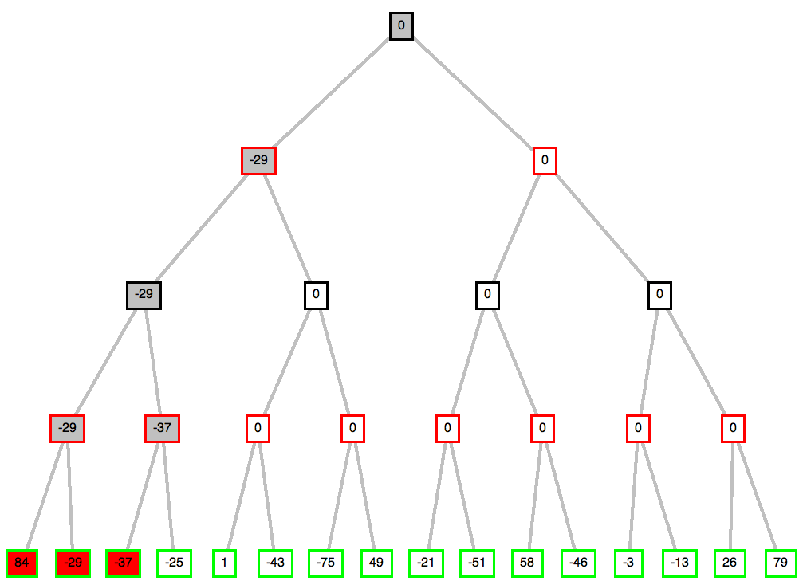
max
min
max
min
© Patrick Winston

Slide 13
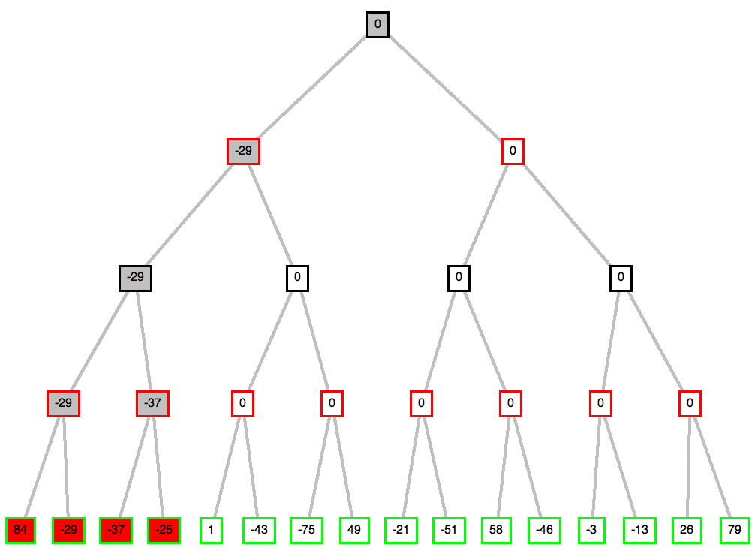
max
min
max
min
© Patrick Winston

Slide 14
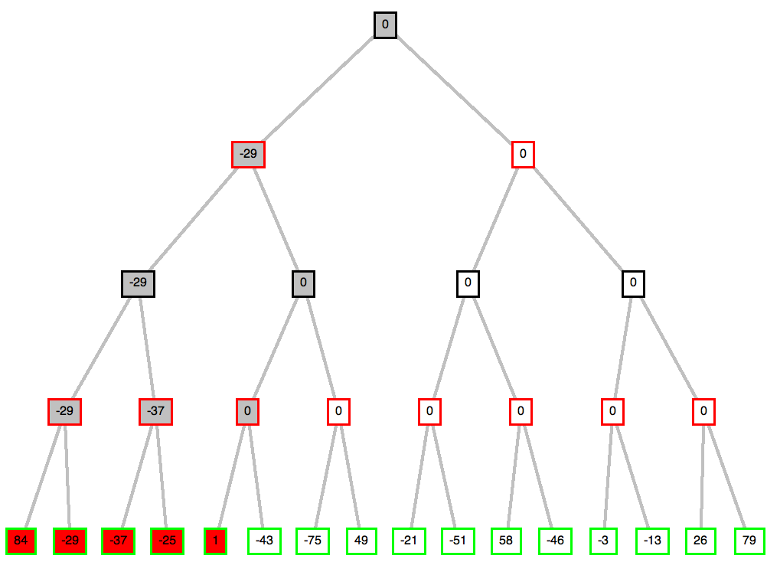
max
min
max
min
© Patrick Winston

Slide 15
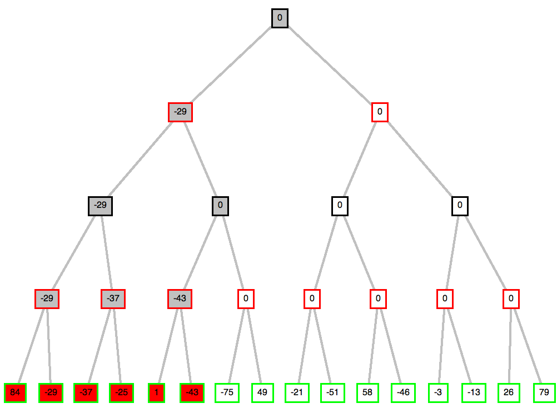
max
min
max
min
© Patrick Winston

Slide 16
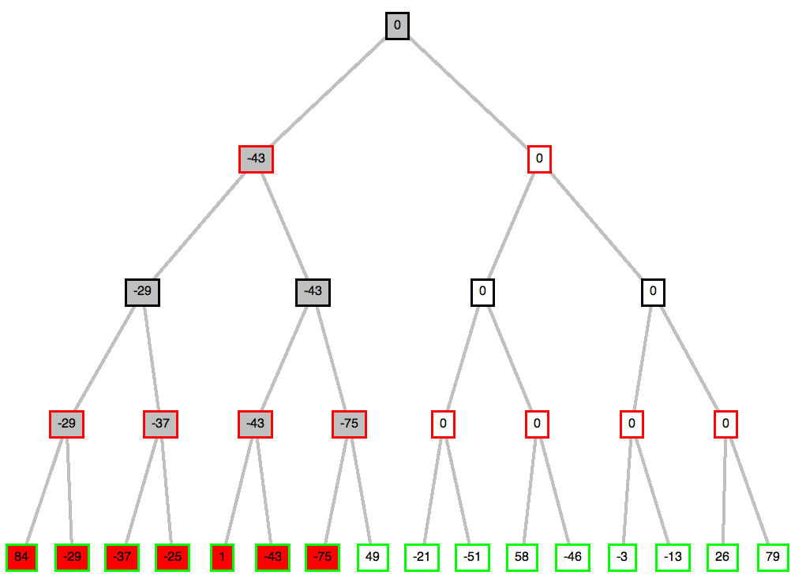
max
min
max
min
© Patrick Winston

Slide 17
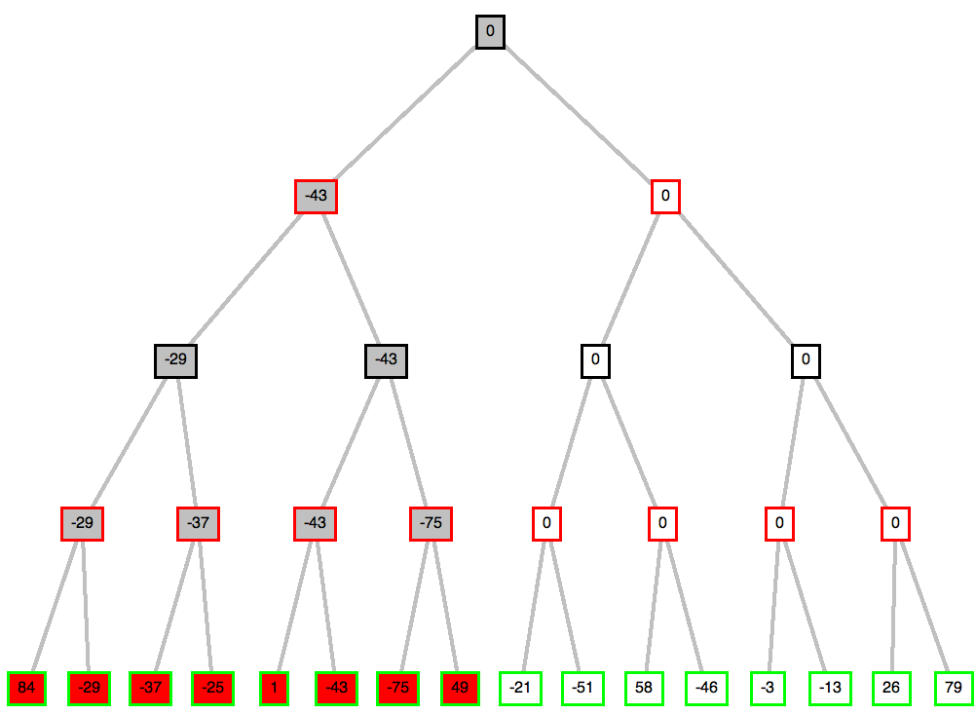
max
min
max
min
© Patrick Winston

Slide 18
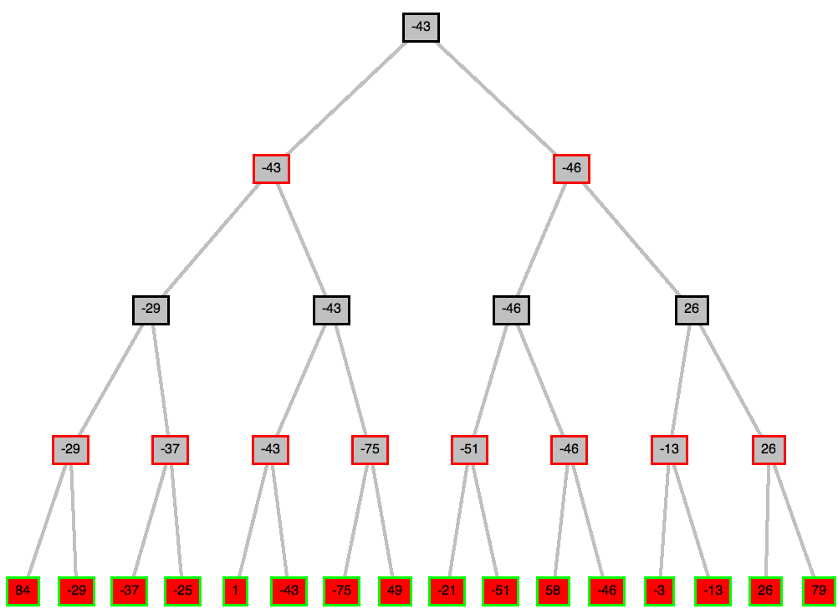
max
min
max
min
© Patrick Winston

Slide 19
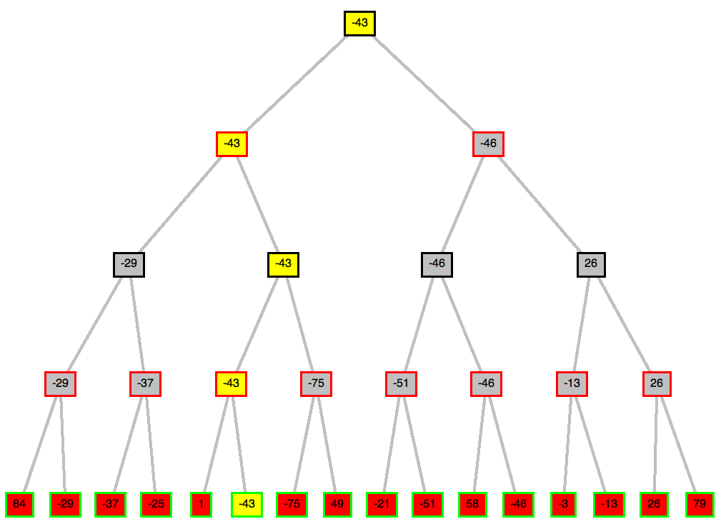
max
min
max
min
© Patrick Winston

Slide 20

Minimax
Perfect play for deterministic games
Idea: choose move to position with highest minimax value
= best achievable payoff against best play
E.g., 2-ply game:

Slide 21
Mini-Max Properties
Complete?
Optimal?
  Against an optimal opponent?
  Otherwise?
Time complexity?
Space complexity?

Slide 22
Mini-Max Properties
Complete? Yes, if tree is finite
Optimal?
  Against an optimal opponent?
  Otherwise?
Time complexity?
Space complexity?

Slide 23
Mini-Max Properties
Complete? Yes, if tree is finite
Optimal?
  Against an optimal opponent? Yes
  Otherwise? No: Does at least as well, but may not exploit opponent weakness
Time complexity?
Space complexity?

Slide 24
Mini-Max Properties
Complete? Yes, if tree is finite
Optimal?
  Against an optimal opponent? Yes
  Otherwise? No: Does at least as well, but may not exploit opponent weakness
Time complexity? O(b^{m})
Space complexity? O(bm)

Slide 25

Minimax algorithm

Slide 26
Alpha-beta pruning
We can improve on the performance of the minimax algorithm through alpha-beta pruning
Basic idea: “If you have an idea that is surely bad, don't take the time to see how truly awful it is.” -- Pat Winston
MAX
>=2
We don’t need to compute the value at this node.
No matter what it is, it can’t affect the value of the root node.
MIN
=2
<=1
MAX
2
7
1
?

Slide 27

α-β pruning example

Slide 28

α-β pruning example

Slide 29

α-β pruning example

Slide 30

α-β pruning example

Slide 31

α-β pruning example

Slide 32
Alpha-Beta Pruning
Pruning = cutting off parts of the search tree (because you realize you don’t need to look at them)
  When we considered A* we also pruned large parts of the search tree
Maintain alpha = value of the best option for player 1 along the path so far
Beta = value of the best option for player 2 along the path so far

Slide 33
max
min
max
min

Slide 34
max
min
max
min

Slide 35
max
min
max
min

Slide 36
max
min
max
min
© Patrick Winston

Slide 37
max
min
max
Do we need to check
this node?
min
??

Slide 38
max
min
max
No - this branch is guaranteed to be worse than what max already has
min
X

Slide 39
Properties of α-β
Pruning does not affect final result
Good move ordering improves effectiveness of pruning
With "perfect ordering," time complexity = O(b^{m/2})
  → doubles depth of search
A simple example of the value of reasoning about which computations are relevant (a form of metareasoning)

Slide 40

Why is it called α-β?
α is the value of the best (i.e., highest-value) choice found so far at any choice point along the path for max
If v is worse than α, max will avoid it
→ prune that branch
Define β similarly for min

Slide 41

The α-β algorithm

Slide 42

The α-β algorithm

Slide 43
Example
-which nodes can be pruned?
5
6
3
4
1
2
7
8

Slide 44
Answer to Example
-which nodes can be pruned?
Max
Min
Max
5
6
3
4
1
2
7
8
Answer: NONE! Because the most favorable nodes for both are explored last (i.e., in the diagram, are on the right-hand side).

Slide 45
Second Example
(the exact mirror image of the first example)
-which nodes can be pruned?
3
4
6
5
8
7
2
1

Slide 46
Answer to Second Example
(the exact mirror image of the first example)
-which nodes can be pruned?
Max
Min
Max
3
4
6
5
8
7
2
1
Answer: LOTS! Because the most favorable nodes for both are explored first (i.e., in the diagram, are on the left-hand side).

Slide 47
Summary
Games are fun to work on!
good idea to think about what to think about
They illustrate several important points about AI
perfection is unattainable → must approximate

